Slide 1

Recommendation System - Amazon Books
Ashwini Kulkarni
Sindhu Balakrishnan

Slide 2
Project Goal
Goal of the project is to build a recommendation system which would suggest the user with products which has a likelihood that he/she might prefer to buy.
This methodology is similar to suggested products section in Amazon website:

Slide 3
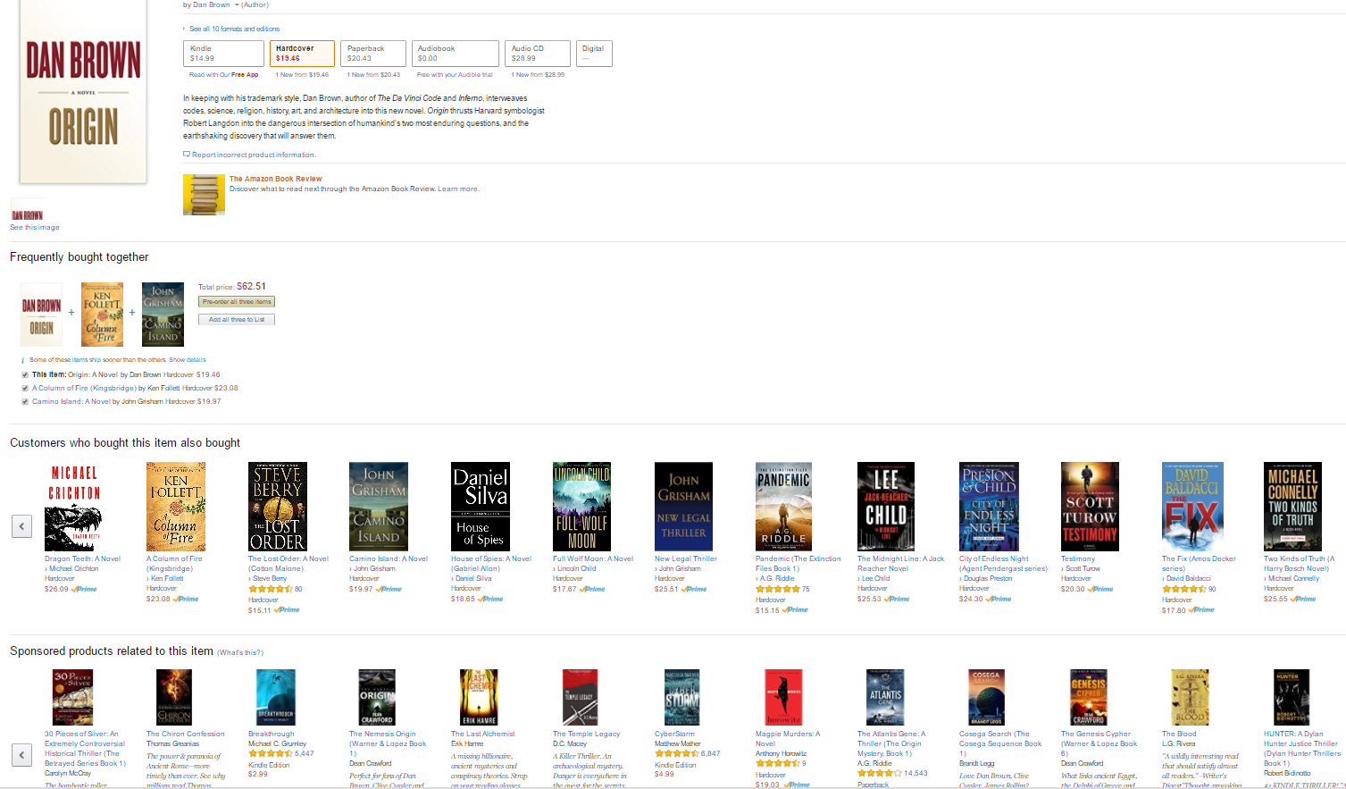

Slide 4
Application Areas:
This project methodology can be applied in domains where historical order information is available. This includes but not limited to systems like online retail sites, movie/ restaurant recommendations etc

Slide 5
Methodology
General Methods in Recommendation Systems:-
1. Content-based filtering:
Recommending items similar to what users already like.
2. Collaborative filtering:
Recommending items based on what similar users like. Collaborative filtering approach is opted for this project.

Slide 6
Collaborative filtering
If two users have exhibited similar preferences (that is, patterns of interacting with the same items in broadly the same way), then we would assume that they are similar to each other in terms of taste. To generate recommendations for unknown items for a given user, we can use the known preferences of other users that exhibit similar behavior.
We can do this by selecting a set of similar users and computing some form of combined score based on the items they have shown a preference for.
The overall logic is that if others have tastes similar to a set of items, these items would tend to be good candidates for recommendation.

Slide 7
Technology :
Processing Paradigm: Spark
Programing language: JAVA with Maven Lib
Data Source :
Dataset used is historical Amazon books review from:
http://jmcauley.ucsd.edu/data/amazon/

Slide 8
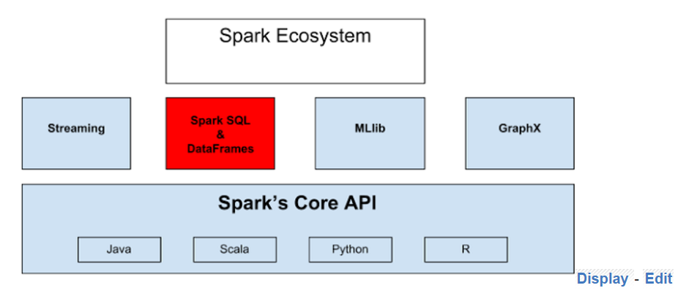
Spark Ecosystem

Slide 9
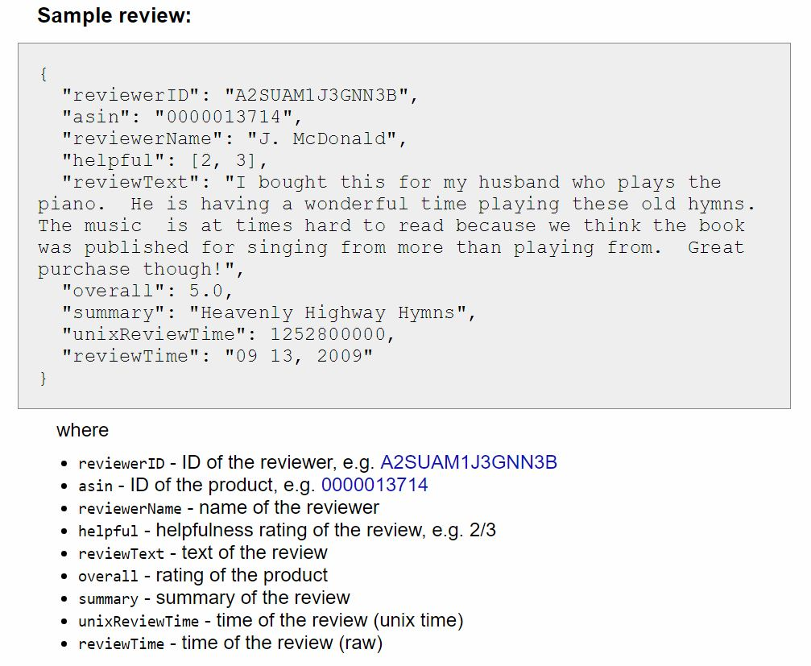
Data Format

Slide 10
Data Information
This dataset contains book reviews from Amazon, including 142.8 million reviews spanning May 1996 - July 2014. This dataset includes reviews (ratings, text, helpfulness votes).
We are mainly focusing on following two features in our implementation.
Feature ID | Description
User ID | Contains reviewer ID
Product ID | Unique ID for Each Product

Slide 11
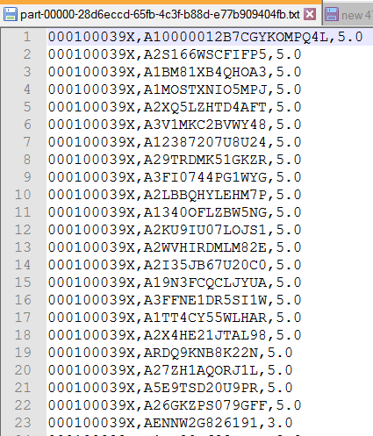
Data Pre-processing:
Execution Plan
Loading JSON to a comma separated file:
spark-submit --class amazonbk.bk.LoadData --master local[2] /ProjectJAVA/amazon/bk-0.0.1-SNAPSHOT.jar /ProjectJAVA/amazon/Books_5.json /ProjectJAVA/amazon/output

Slide 12
Our Approach
Input: UserID
Steps:
Program finds the past list of books bought by the user - List A
Program searches the whole dataset and returns users who have bought books in List A
Find all the books bought by those users – List B
For each book in list B find maximum sold books - List C
Recommend the top 10 books from list C

Slide 13
Our Approach Contd..
A new Spark RDD created at each step and performs the conditional check
The list returned by the RDD is set to a Broadcast Variable
Maximum sold books are sorted are top 10 records returns the suggestion.

Slide 14
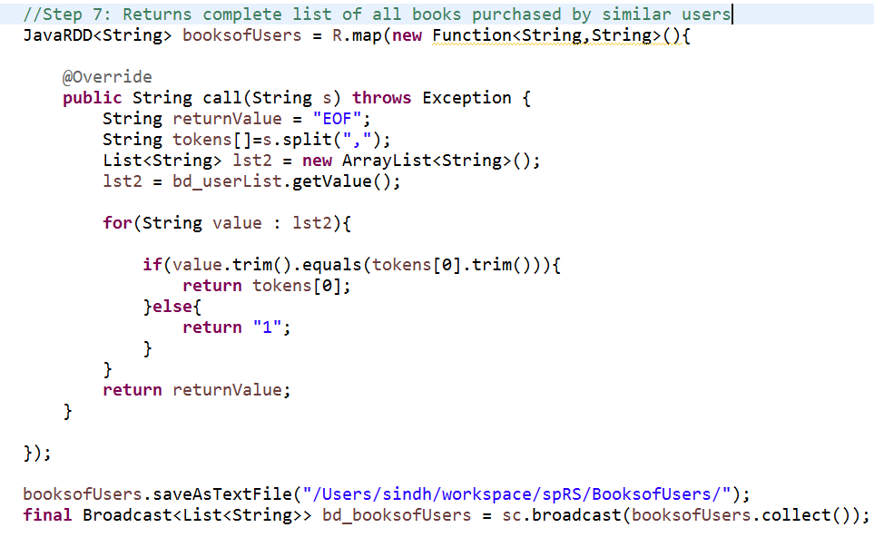
RDD Approach:
RDD 3 – Returns list of books purchased by similar pref. users.

Slide 15
Expected Output
On specifying an user id as input, it should return top book suggestions after spanning through 142.8 million book reviews within a reasonable period of time.

Slide 16
Conclusion
Project Statement: Suggest user with top book recommendations
Result: Top 10 Book suggestion for the user based on his past preferences.

Slide 17
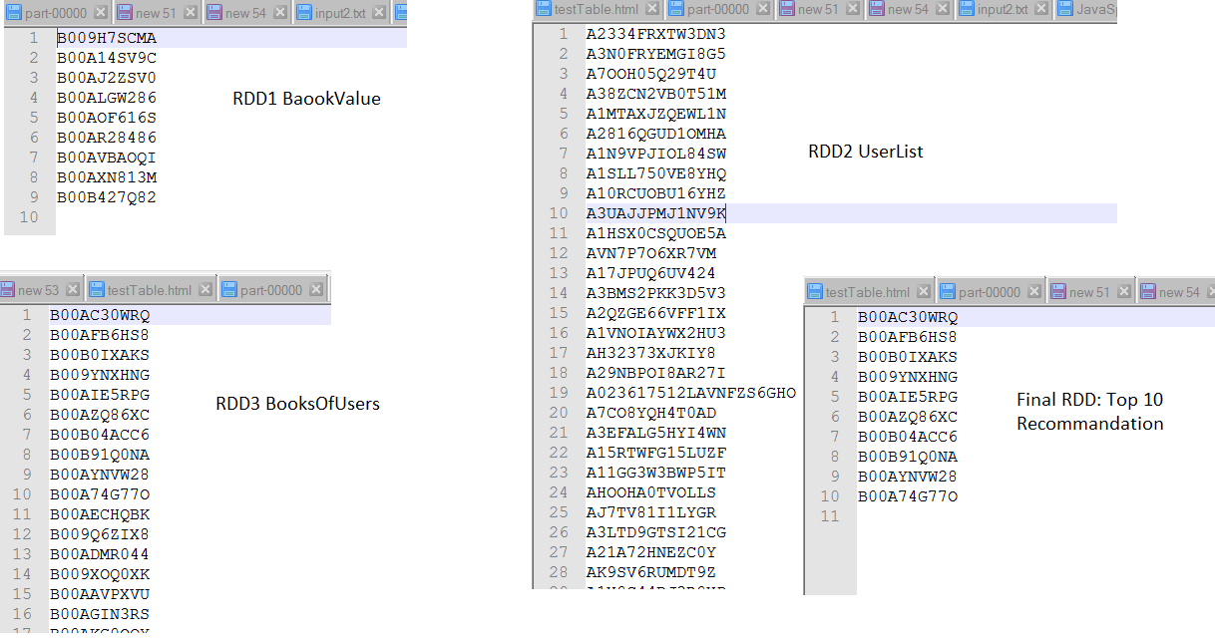
Actual Output

Slide 18
Future Scope I
Currently, implementation is based on user’s past history. Future work, can include suggestions for new users too.
Try a hybrid approach:
Cascade (Content + Collaborative Filtering)
After content based filtering, collaborative filtering can be applied to refine the recommendations even more.
Integrating (Content + Collaborative Filtering + K-Means)
Recommendations by more than 1 algorithm could be more accurate.

Slide 19
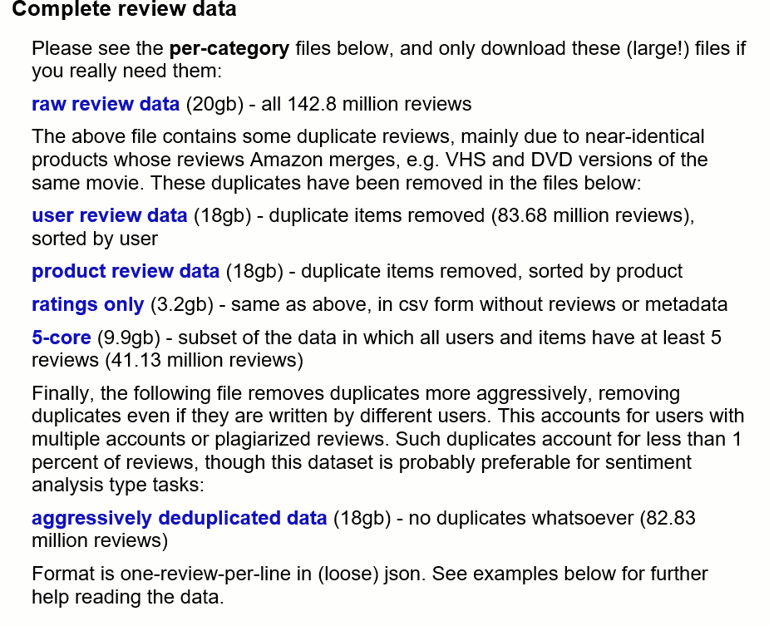
Future Scope II
Implementation using Real Time data
Expand applications for other attributes
Minimizing large file processing time

Slide 20
References:
http://jmcauley.ucsd.edu/data/amazon/
https://www.packtpub.com/books/content/building-recommendation-engine-spark
https://bugra.github.io/work/notes/2014-04-19/alternating-least-squares-method-for-collaborative-filtering/
https://www.slideshare.net/CasertaConcepts/analytics-week-recommendations-on-spark

Slide 21


Slide 22
Thanks

